Slide 1

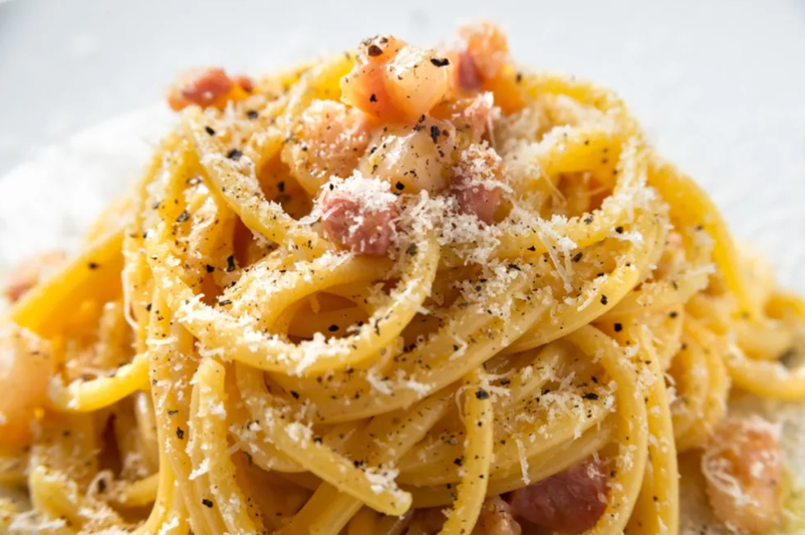
CAPSTONE PROJECT
OPENING A NEW ITALIAN RESTAURANT
IN TORONTO
Tommaso Colli
June 16, 2020

Slide 2

CONTENTS
1
4
2
5
3
6
TARGET AUDIENCE
INTRODUCTION
GOAL
DATA
METHODOLOGY
RESULTS

Slide 3
CONTENTS
7
9
8
RECOMMENDATIONS
LIMITATIONS AND SUGGESTIONS FOR FUTURE RESEARCH
CONCLUSION

Slide 4

Furthermore, Italian cuisine is considered the most appreciated cuisine in the world and, as an Italian living abroad, I know that many times the authenticity of the food provided by Italian restaurants abroad is debatable. So, a new Italian restaurant opened under the supervision of an Italian might be a great recipe for success. Through a quick search, I have found out that most of the Italian population of Toronto lives in Etobicoke Centre. This Project will have to prove whether that location might be ideal, or if another location would be more suitable.
INTRODUCTION
For this Capstone Project I am evaluating the opening of a new Italian restaurant in Toronto, and the area where it would be best to open it.
The basis of this valuation is the following: there is a high concentration of Italians in Toronto; namely, over 180,000 Italians, accounting for 7% of the overall population.

Slide 5

GOAL & TARGET AUDIENCE
The goal of this Project is to find
the most suitable location for a new Italian restaurant in Toronto, Canada.
The entrepreneur willing to proceed in the opening of a new Italian restaurant in Toronto.

Slide 6

DATA
The data necessary for this Project is:
- The list of neighborhoods of Toronto
- The latitude and longitude of each neighborhood
- The list and location of existing Italian restaurants in Toronto

Slide 7

METHODOLOGY
1) Obtaining the list of neighborhoods of Toronto, Canada.
From: “https://en.wikipedia.org/wiki/List_of_postal_codes_of_Canada:_M”.
2) Web scraping with pandas, in order to obtain tabular data from the web page and create a dataframe.
3) Adding the coordinates of each neighborhood to the list of names and postal codes, with Foursquare.
4) Visualizing on a map each neighborhood, correctly positioned with the related coordinates, using Folium package.
5) Obtaining the list of top 100 venues within a 500 meters radius, in order to focus the attention on Italian restaurants. With Foursquare API I can also obtain name, category, latitude and longitude of every venue.
6) Grouping by neighborhood, then clustering through k-means.
7) Suggesting the most suitable location for a new Italian restaurant in Toronto, Canada.

Slide 8
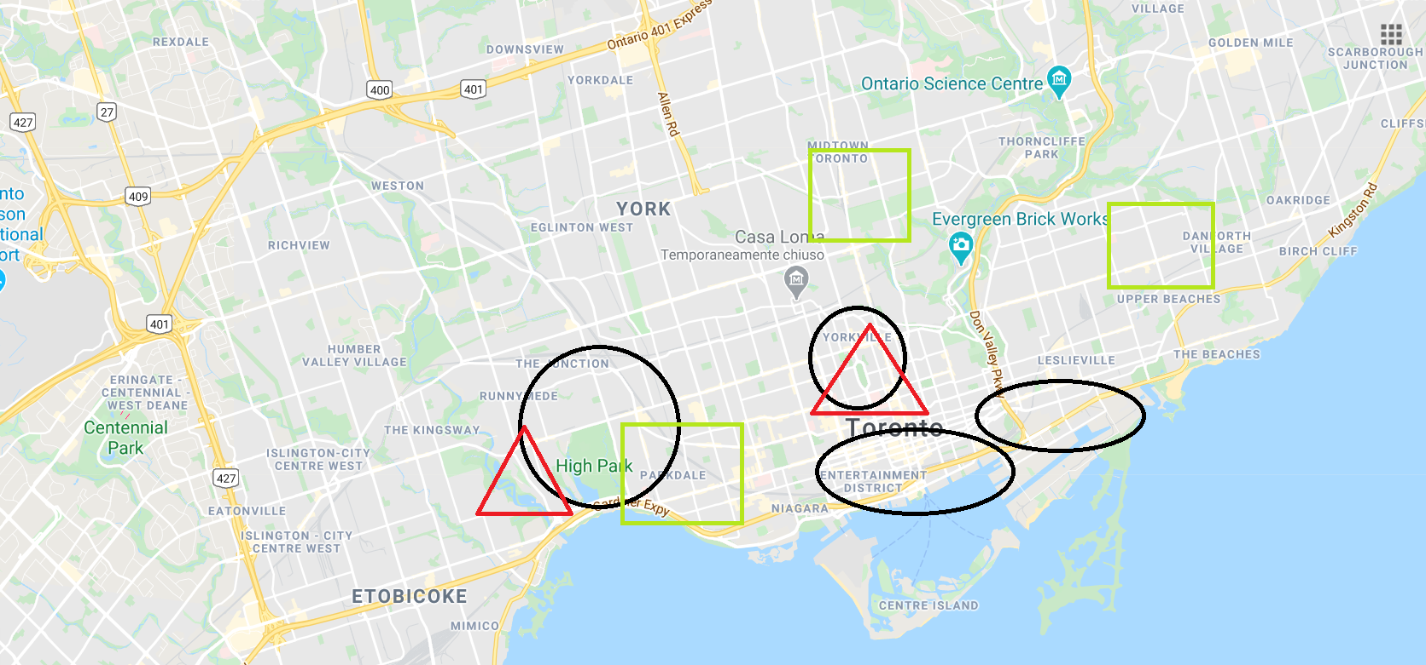
RESULTS
Here below a picture that shows the map of Toronto and the main areas where other Italian restaurants are located.
LEGENDA:
BLACK OVALS = CLUSTER 1
GREEN RECTANGLES = CLUSTER 2
RED TRIANGLES = CLUSTER 4

Slide 9
COMMENTS ON RESULTS
Through k-means clustering I divided Toronto into 5 clusters.
However, I only highlighted cluster 1,2 and 4, being the more relevant ones.
In order of relevance we have cluster 2, then cluster 4, and finally cluster 1. Cluster 0 had no Italian restaurants, and cluster 3 was the 4th more relevant.

Slide 10

RECOMMENDATIONS
As anticipated in the results, most of the Italian restaurants are located in cluster 2, then 4, 1, and finally cluster 3.
The areas to focus on, in order of priority for the opening of a new Italian restaurant would then be around High Park, or the area of Yorkville / Central Bay Street.

Slide 11
LIMITATIONS AND SUGGESTIONS FOR FUTURE RESEARCH
The main assumption of this project is that opening a new Italian restaurant in an area that has already some other Italian restaurants would be a good idea.
The second valuation has been to identify the area that has the highest concentration of Italian population: Etobicoke.
The final valuation has been to consider the average prices of real estate in different areas of Toronto.
For future research, it could be useful to consider areas that have a lower presence of Italian restaurants but might be still promising for the purpose of opening a new Italian restaurant.

Slide 12
CONCLUSION
I would suggest the entrepreneur to consider opening
the new Italian restaurant either in the area of High Park,
or in the area of Yorkville / Central Bay Street.
By checking the real estate prices in Toronto, I can add that
the closer we go to Etobicoke, the lower the prices of store would be. In that area we could take advantage of both a high Italian population, as well as more affordable real estate. The decision to locate in this area could work for a less posh, "home-cooked" style of restaurant.
On the other hand, if the idea is to open a very chic, high-end restaurant, it could be worth it to explore a more central area, which could benefit from a population of higher-spenders, who probably work and/or live in that area.

Slide 13

MANY THANKS FOR YOUR ATTENTION!

